Slide 1
Business process (re)engineering implementation and strategies

Slide 2
BPE
Introduction
Objectives
Characteristics
Life Cycle
Success Factors
Limitations
Conclusion

Slide 3
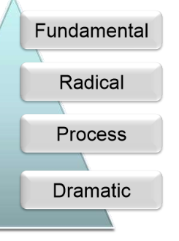
Definition Of BPR
The fundamental rethinking and radical redesign of business process to bring about dramatic improvements in performance such as cost, quality, service and speed.

Slide 4
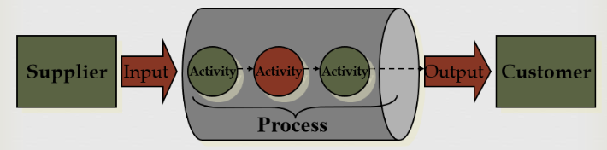
What is Process
A process is a cross-functional interrelated series of activities that convert business inputs into business outputs
Notes:
Cross-functional process is a process that involves multiple divisions, each of which makes its part of the entire company workflow. For example: product development, lead management , client orders processing – and other critical processes.

Slide 5
What is a Business Process
A group of logically related tasks that use the firm's resources to provide customer-oriented results in support of the organization's objectives

Slide 6
Method Study Questions for Process Analysis
What does the customer need?
operations are necessary?
Can some operations be eliminated, combined, or simplified?….
Who is performing the job?
Can the operation be redesigned to use less skill or less labor?
Can operations be combined to enrich jobs? ….
Where is each operation conducted?
Can layout be improved?
When is each operation performed? Is there excessive delay or storage?
Are some operations creating bottlenecks?
How is the operation done? Can better methods, procedures, or equipment be used?
Notes:
Job enrichment is a process that is characterized by adding dimensions to existing jobs to make them more motivating. Examples of job enrichment include adding extra tasks (also called job enlargement), increasing skill variety, adding meaning to jobs, creating autonomy, and giving feedback

Slide 7
Why Re-engineering?
3Cs – The Driving Force Behind Reengineering
Customer
Competition
Change

Slide 8
Driving Forces
Customers
Demanding
Sophistication
Changing Needs
Competition
Local
Global
Change
Technology
Customer Preferences
Notes:
consumer sophistication as. "an individual's aggregate level of acquired knowledge, experience in. purchasing products, and skills which are relevant to being an effi. cient decision-maker

Slide 9
Objectives of BPR:
Speed
Flexibility
Quality
Innovation
Productivity
Notes:
Productivity is a measure of efficiency of a person completing a task. We often assume that productivity means getting more things done each day. Wrong. Productivity is getting important things done consistently.

Slide 10
Characteristics of BPR
Radical Improvement
Integrated Change
People Centered
Focus on End-Customers
Process-Based

Slide 11
Radical Improvement
Sustainable
Process improvements need to become firmly rooted within the organization
Stepped Approach
Process improvements will not happen over night they need to be gradually introduced
Also assists the acceptance by staff of the change
Notes:
able to be maintained at a certain rate or level.

Slide 12
Integrated Change
Viable Solutions
Process improvements must be viable and practical
Balanced Improvements
Process improvements must be realistic
Notes:
capable of working succ
realistic is someone who has a good grip on the reality of a situation and understands what can and cannot be done, something that is a practical, achievable idea, or something that resembles the actual truth about life.essfully; feasible.

Slide 13
People-Centered
Business Understanding
Empowerment & Participation
Organizational Culture
Notes:
Participation represents action, or being part of an action such as a decision-making process. Empowerment represents sharing control, the entitlement and the ability to participate, to influence decisions, as on the allocation of resources'.
Organizational culture is the collection of values, expectations, and practices that guide and inform the actions of all team members. Think of it as the collection of traits that make your company what it is.

Slide 14
Process Based
Added Value
BPR Initiatives must add-value over and above the existing process
Customer-Led
BPR Initiatives must meet the needs of the customer
Notes:
Customer-led companies are characterized by an increasingly strong employee focus on customers, a shared understanding of key customers, an effort to satisfy customer segments, the ability to bring customer propositions to market, and a high level of employee engagement.

Slide 15
Focus on End Customers
Process improvements must relate to the needs of the organization and be relevant to the end-customers to which they are designed to serve

Slide 16
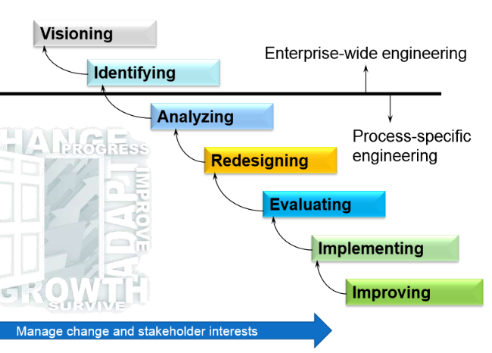
BPR Life Cycle:

Slide 17
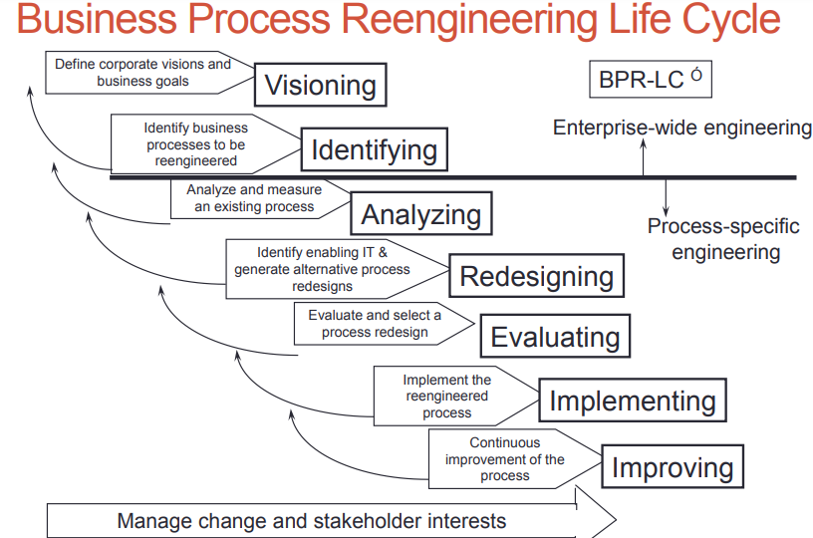

Slide 18
Success Factors Of BPR
Clear Vision for Transformation
Reduction of Cycle time
Greater Accuracy
Increased customer satisfaction
Reduced cost
Change Management

Slide 19
Principles of re-engineering
Organize around outcomes, not tasks.
Identify all the processes in an organization and prioritize them in order of redesign urgency.
Integrate information processing work into the real work that produces the information.

Slide 20
Principles of re-engineering
Treat geographically dispersed resources as though they were centralized.
Link parallel activities in the workflow instead of just integrating their results.
Put the decision point where the work is performed, and build control into the process.
Capture information once and at the source.

Slide 21
Implementing a BPR strategy
Key Steps
Select The Process & Appoint Process Team
Understand The Current Process
Develop & Communicate Vision Of Improved Process
Identify Action Plan
Execute Plan

Slide 22
Select the Process & Appoint Process Team
Two Crucial Tasks
Select The Process to be Reengineered
Appoint the Process Team to Lead the Reengineering Initiative

Slide 23
Select the Process
Review Business Strategy and Customer Requirements
Select Core Processes
Understand Customer Needs
Don‟t Assume Anything

Slide 24
Select the Process
Select Correct Path for Change
Remember Assumptions can Hide Failures
Competition and Choice to Go Elsewhere
Ask - Questionnaires, Meetings, Focus Groups
Notes:
A focus group is a market research method that brings together 6-10 people in a room to provide feedback regarding a product, service, concept, or marketing campaign. A trained moderator leads a 30-90-minute discussion within the group that is designed to gather helpful information.

Slide 25
Appoint the Process Team
Appoint BPR Champion
Identify Process Owners
Establish Executive Improvement Team
Provide Training to Executive Team

Slide 26
Core Skills Required
Capacity to view the organization as a whole
Ability to focus on end-customers
Ability to challenge fundamental assumptions
Courage to deliver and venture into unknown areas
Ability to assume individual and collective responsibility
Employ „Bridge Builders‟
Notes:
efforts to establish communications and friendly contacts between people in order to make them friends or allies.

Slide 27
Use of Consultants
Used to generate internal capacity
Appropriate when a implementation is needed quickly
Ensure that adequate consultation is sought from staff so that the initiative is organization-led and not consultant-driven
Control should never be handed over to the consultant

Slide 28
Understand the Current Process
Develop a Process Overview
Clearly define the process
Mission
Scope
boundaries
Set business and customer measurements Understand customers expectations from the process (staff including process team)

Slide 29
Understand the Current Process
Clearly Identify Improvement Opportunities Quality
Rework
Document the Process
Cost
Time
Value Data
Notes:
The source of your data. ...
Cleanliness. ...
Size. ...
Age. ...
Insights. ...
Actionable. ...
Timeliness. ...

Slide 30
Develop & Communicate Vision of Improved Process
Communicate with all employees so that they are aware of the vision of the future
Always provide information on the progress of the BPR initiative - good and bad.
Demonstrate assurance that the BPR initiative is both necessary and properly managed
Notes:
Demonstrate assurance. Projects provides the ability to automatically aggregate risk assessments, testing results, and issues across the entire project into a single assurance metric (percentage) that can be used for reporting purposes.

Slide 31
Develop & Communicate Vision of Improved Process
Promote individual development by indicating options that are available
Indicate actions required and those responsible
Tackle any actions that need resolution
Direct communication to reinforce new patterns of desired behavior

Slide 32
Identify Action Plan
Develop an Improvement Plan
Appoint Process Owners
amplify the Process to Reduce Process Time
Remove any Bureaucracy that may hinder implementation
Notes:
a system of government in which most of the important decisions are taken by state officials rather than by elected representatives.

Slide 33
Identify Action Plan
Remove no-value-added activities
Standardize Process and Automate Where Possible
Up-grade Equipment
Plan/schedule the changes

Slide 34
Execute Plan
Qualify/certify the process
Define and eliminate process problems
Evaluate the change impact on the business and on customers
Benchmark the process
Provide advanced team training
Notes:
Benchmarking is a process of measuring the performance of a company's products, services, or processes against those of another business considered to be the best in the industry, aka “best in class.” The point of benchmarking is to identify internal opportunities for improvement

Slide 35
Limitations:
Fear of Unknown and Failure
Confusion surrounding BPR
Ineffective BPR teams
Problems related to organizational structure
Problems related to BPR resources

Slide 36
References
Read article 1.1 from book

